Slide 1

Internship PRESENTATION
MENU
ANALYSIS
CONTACT
MANAR
SCHOOL MANAGING SYSTEM
Supervised By : Oussama Rahmouni (under ADSELLO)
By : Houssam Abid

Slide 2
Table Of Content
Introduction
Company Presentation
What's different
Diagrams
Usercase
PERT
Gant
Technologie used
Interfaces and tests
Conclusion

Slide 3
Introduction
During my internship I got to work on a school management system website called "Manar" owned by our trainer and supervisor M.Oussama Rahmouni which aims at giving the website users the best experience and have one of the best control of all the courses ,data and learning..to whoever the users are either the parents ,students or teachers..

Slide 4

Company Presentation
ADSELLO (paperless) aims to highlight the best services and solutions for the benefit of clients, while providing professional support to democratize access to effective and tailored IT solutions specifically designed for the reality of each business. It provides consulting (Expert advice to clients, creativity and innovation, analytical skills, flexibility, and the ability to handle pressure and challenges), IT Solutions (Our qualifications in system and network computing allow us to implement solutions tailored to the smooth operation of your information system), Development (Web, Mobile, or custom), and Outsourcing (We provide you with a team of talented specialists with extensive experience dedicated to supporting you in your project)

Slide 5
What's different
This provides for the users all what they want in one place It has a big management side where It manages the notes ,courses ,classes ,times.. as well as it provides an E-learning side that a lot of other websites like this doesn't have and it contains quizzes ,seprate courses and many other advantges

Slide 6
What's different
During my internship, I was assigned to work on a part of the E-learning feature, which involved displaying tables and creating interactive tiles that can be dragged and dropped. Additionally, I was tasked with implementing the functionality to import and export Excel files. Furthermore, I was got asked to develop a script to handle content translation stored in JSON files for the website

Slide 7
DIAGRAMS
Gant ,Pert and usercase

Slide 8
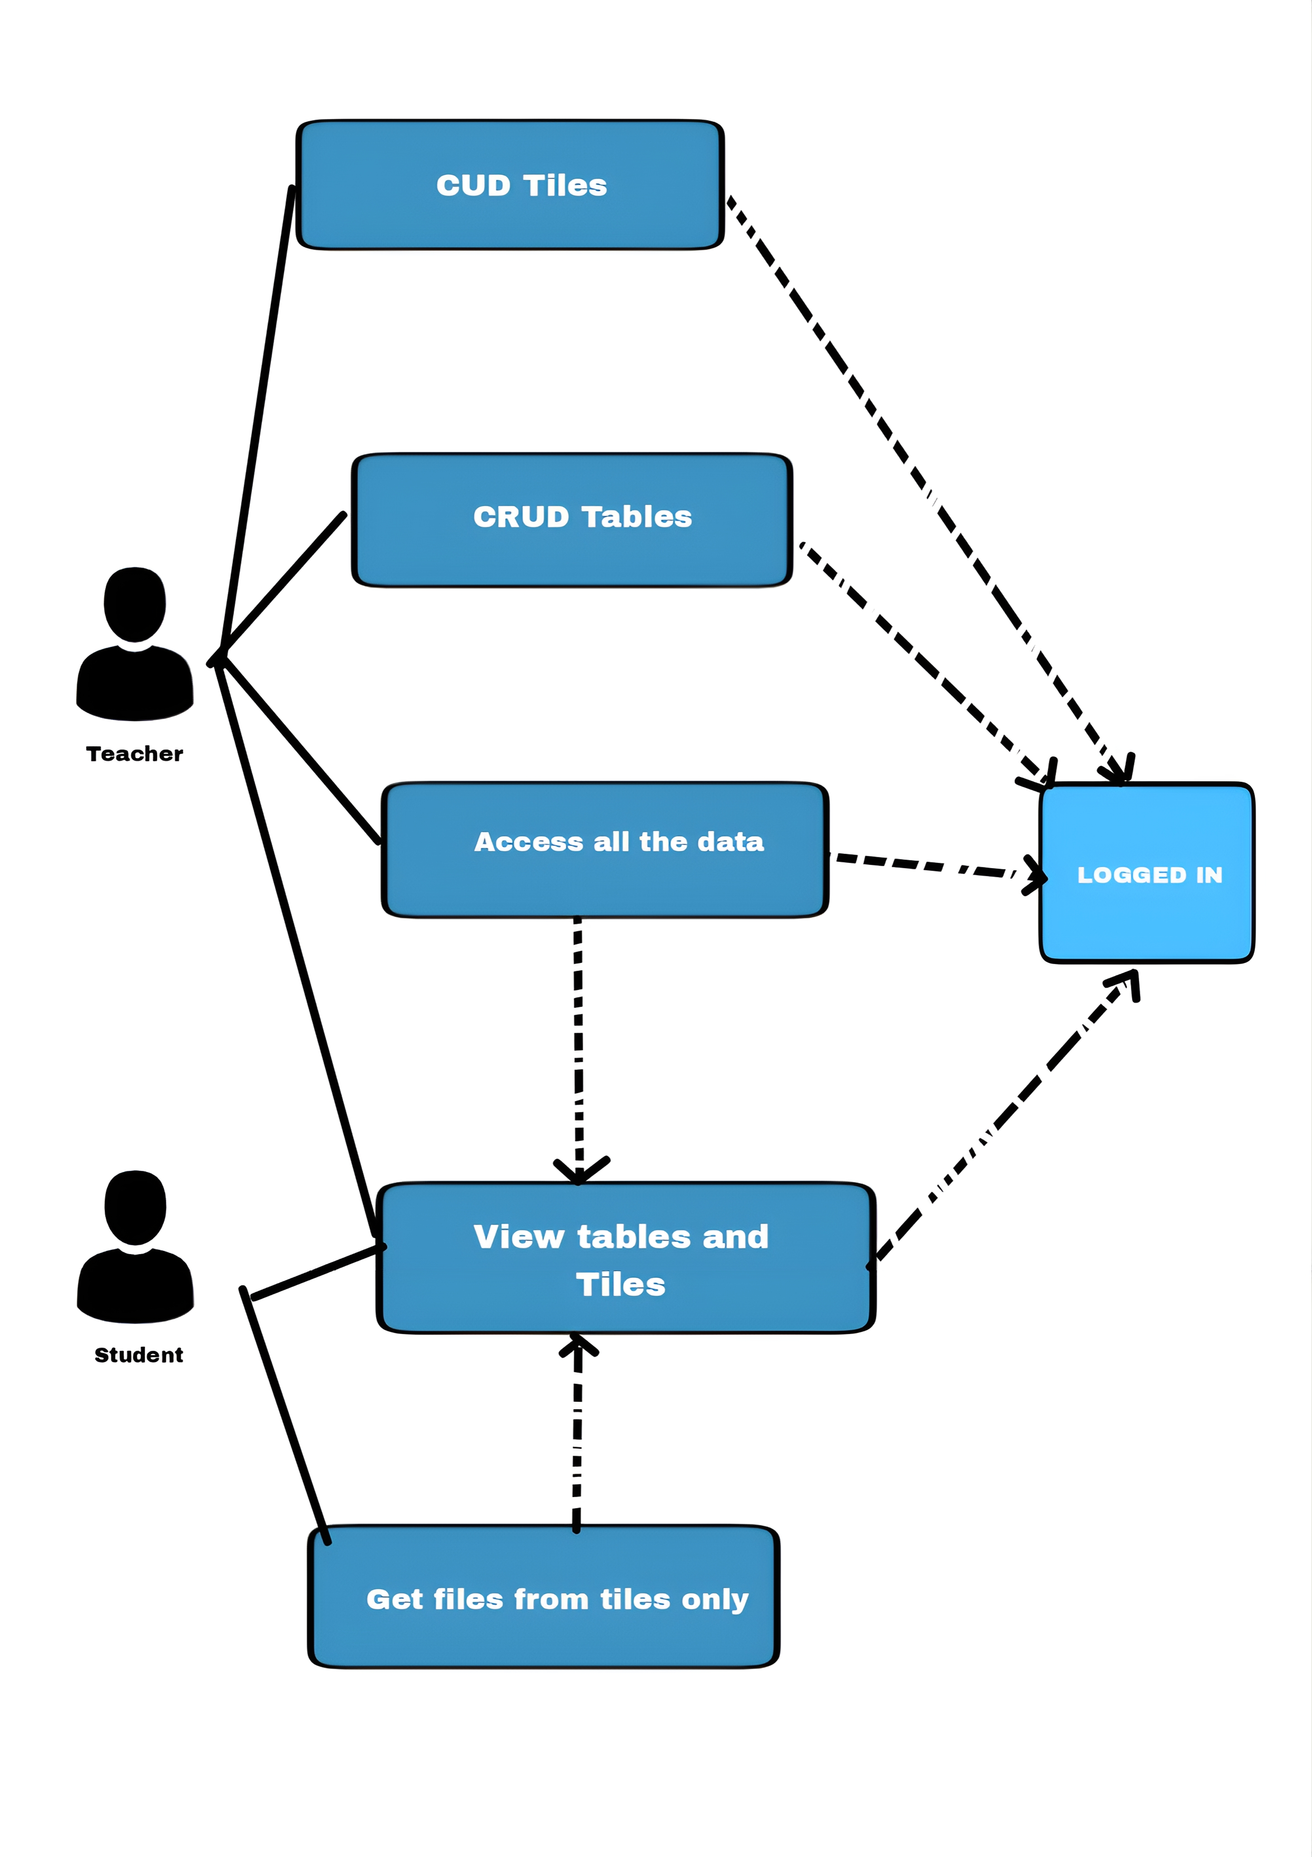
Usercase

Slide 9
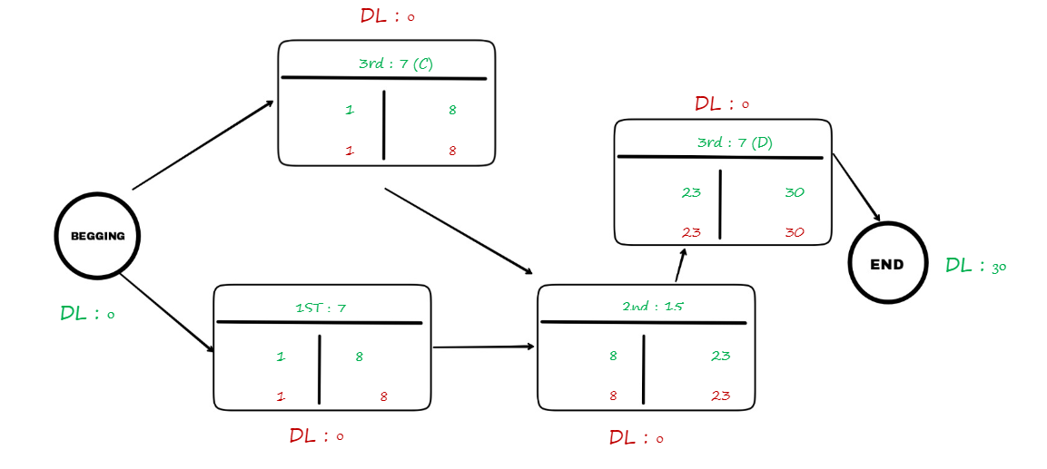
Pert

Slide 10
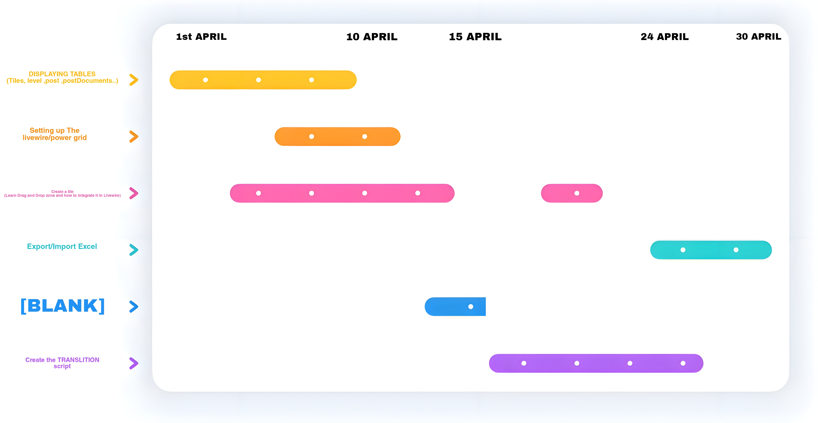
Gant

Slide 11





Technologie used
•We will be using the Laravel framework, which is a popular and powerful PHP framework, for the development of the application.
•MySQL 8 offers advanced features, improved performance, and enhanced security.
Livewire is a PHP framework that enables the development of interactive web applications using the Laravel framework."Powergrid" refers to a Laravel package or library that provides functionality for creating data grids or tables with advanced features and capabilities
"Powergrid" refers to a Laravel package or library that provides functionality for creating data grids or tables with advanced features and capabilities
Laravel
MySQL 8 for DB
LARAVEL’s
Livewire and powergrid
Python
L
MysQL
P&L
Py

Slide 12
Interfaces and tests screenshots

Slide 13
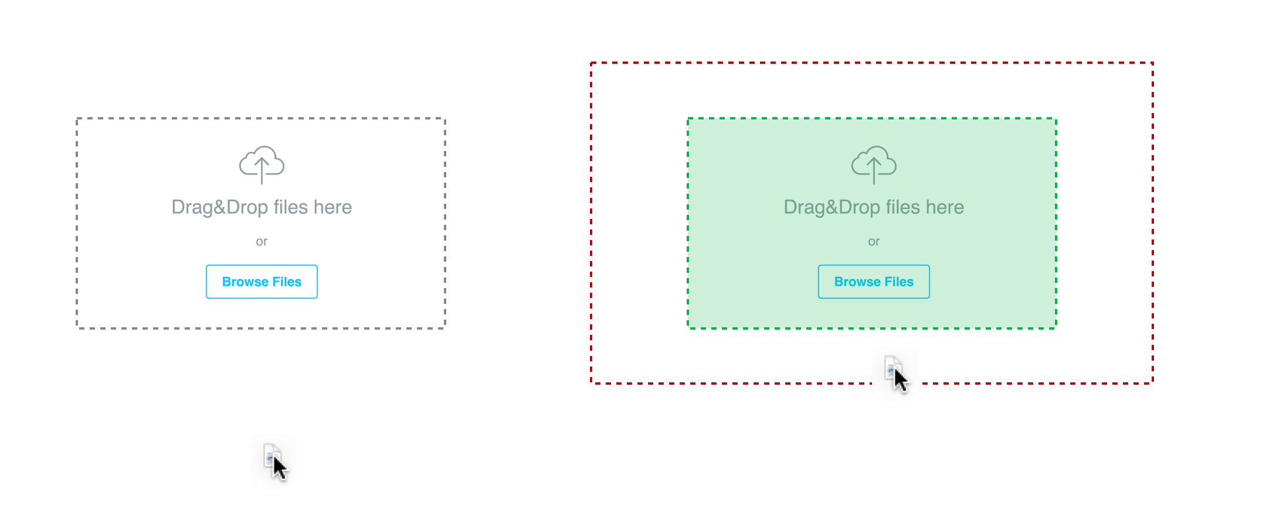
Interfaces and tests Here are the drag and drops

Slide 14
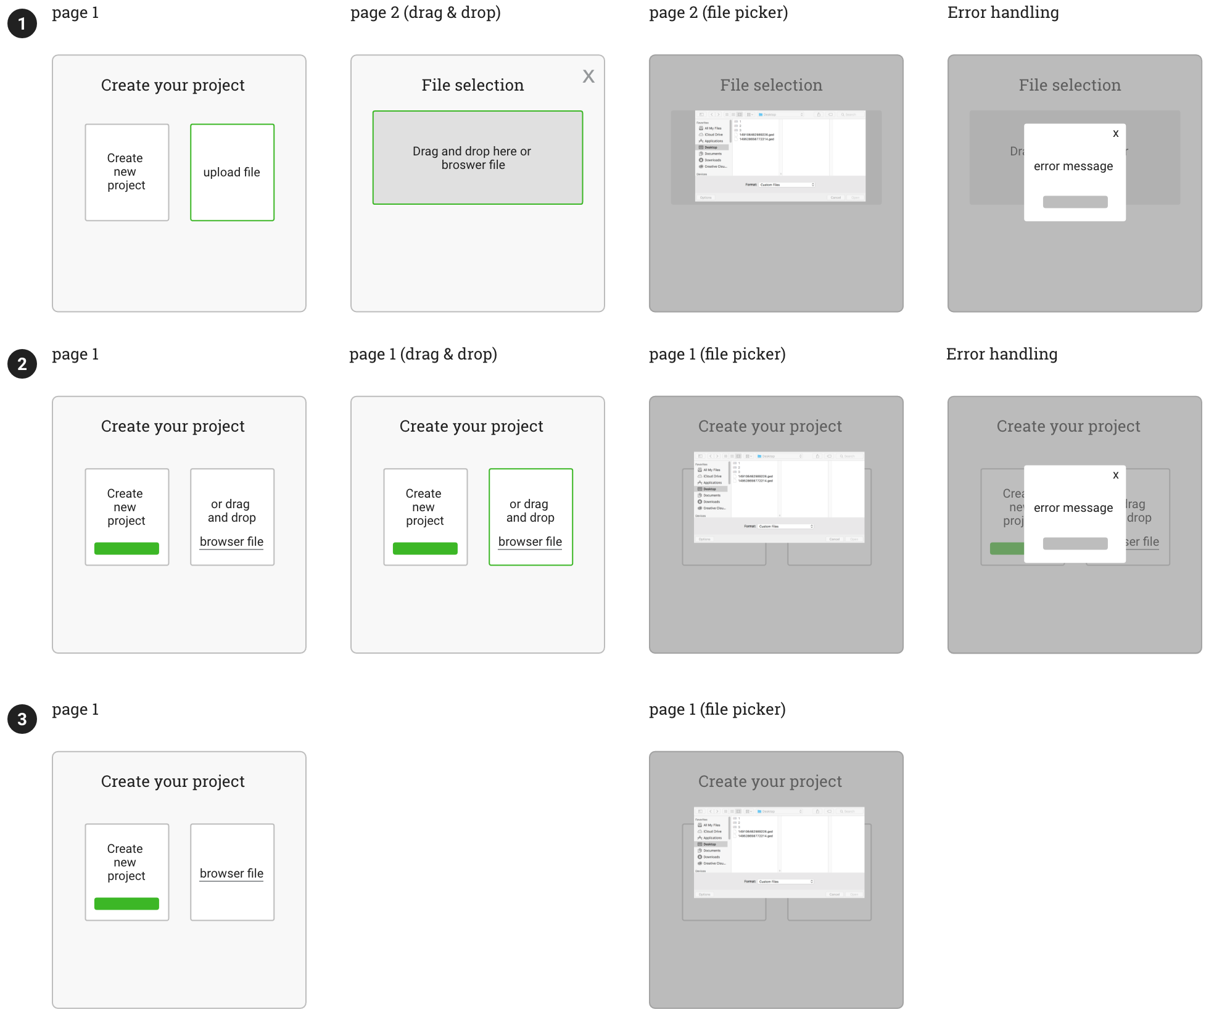
Interfaces and tests Here are the drag and drops whith some errr handling

Slide 15
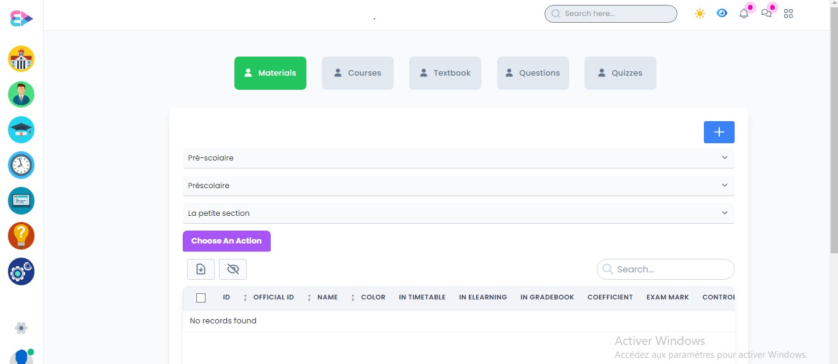
Interfaces and tests Here are some of the finals interfaces

Slide 16
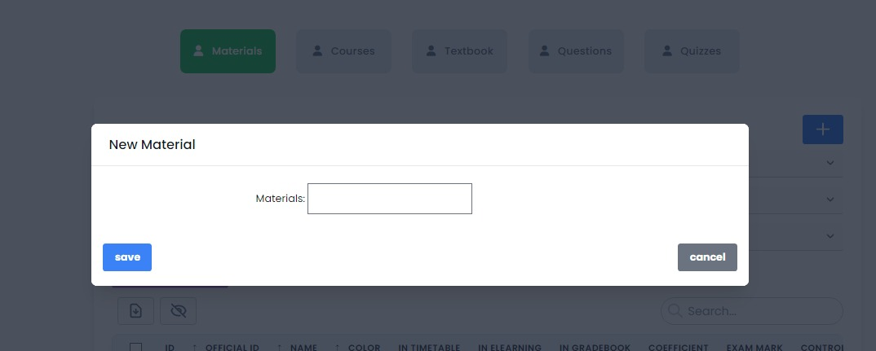
Interfaces and tests Here are some of the finals interfaces

Slide 17
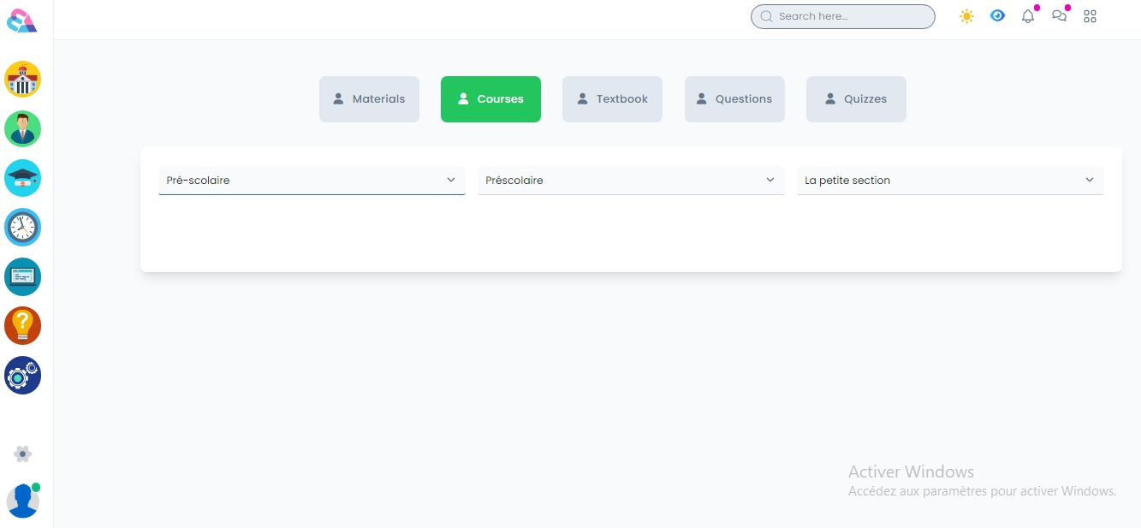
Interfaces and tests Here are some of the finals interfaces

Slide 18
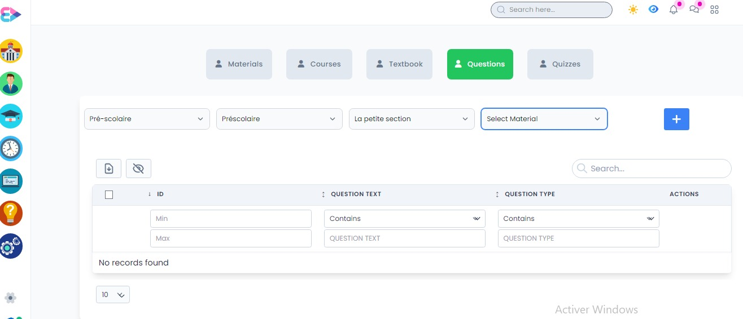
Interfaces and tests Here are some of the finals interfaces

Slide 19
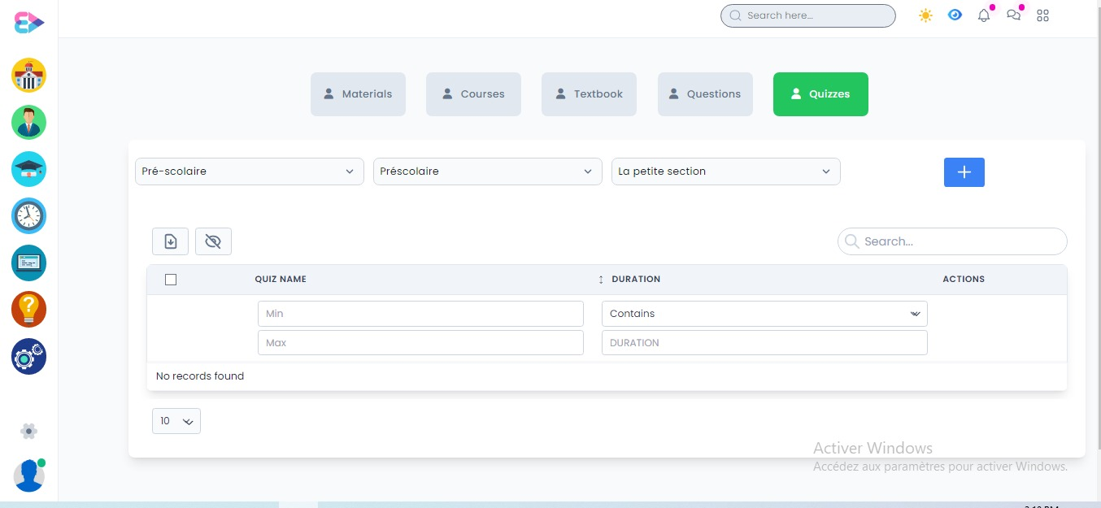
Interfaces and tests Here are some of the finals interfaces

Slide 20
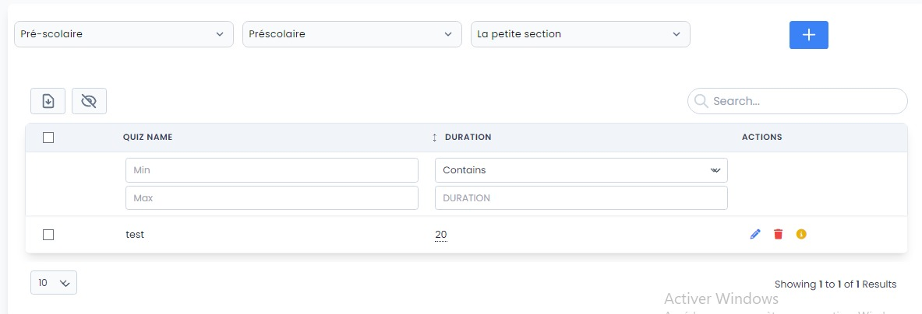
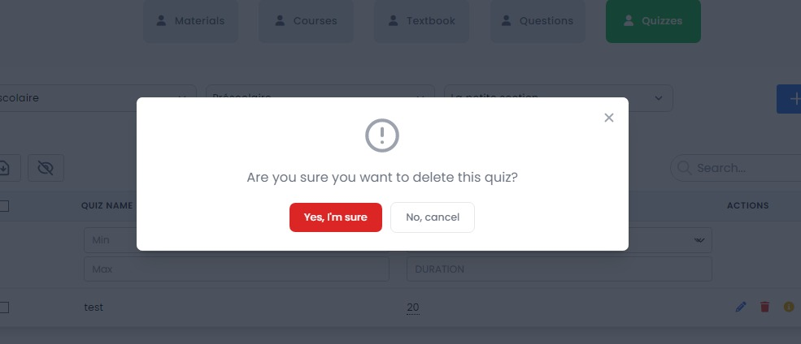
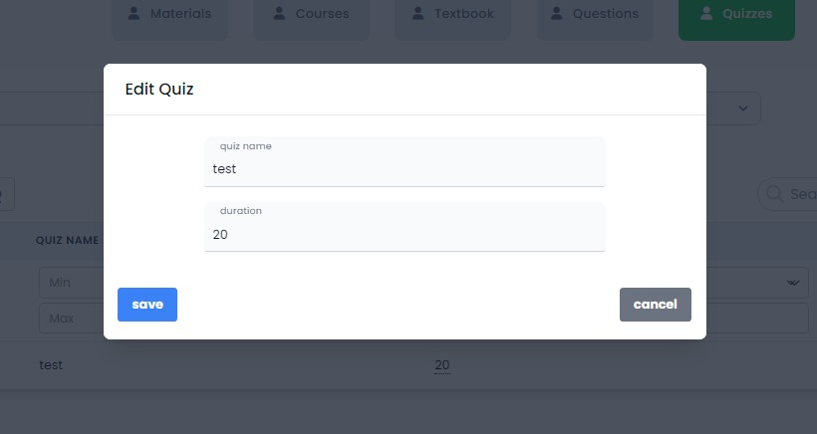
Interfaces and tests Here are some of the finals interfaces

Slide 21
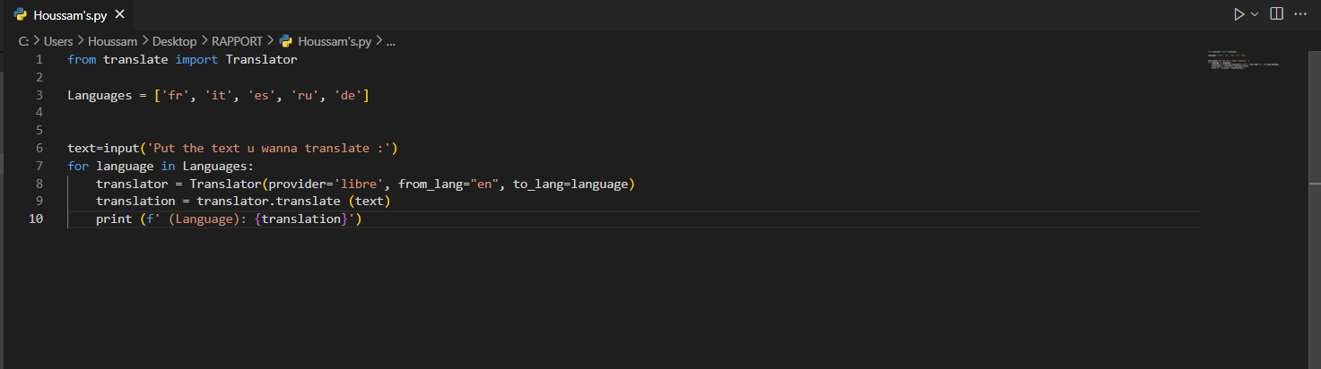
Interfaces and tests Here’s the python scrip

Slide 22
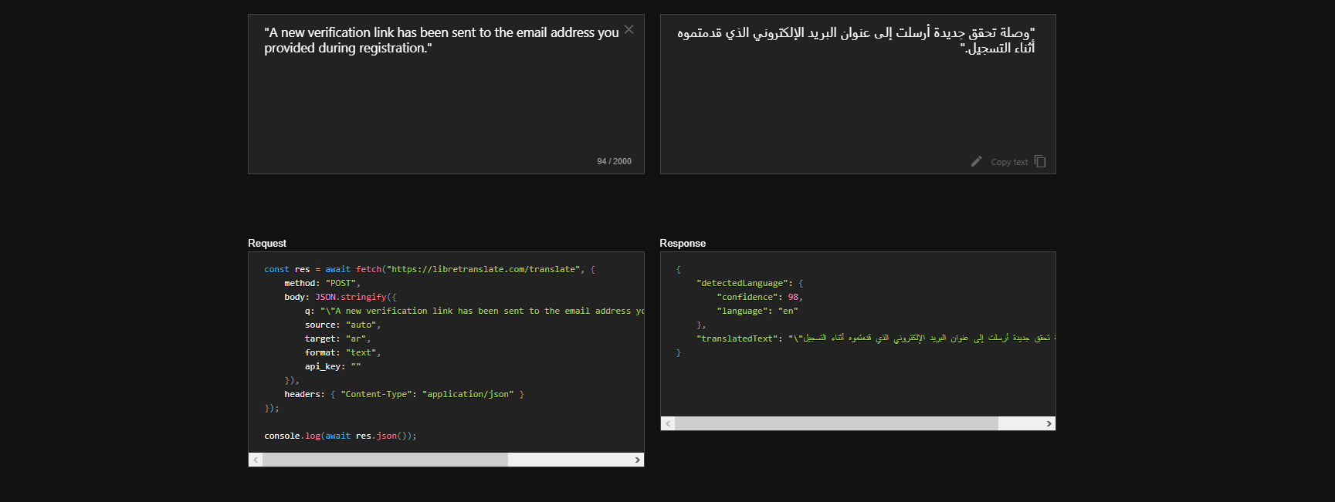
Interfaces and tests Here’s the python scrip

Slide 23
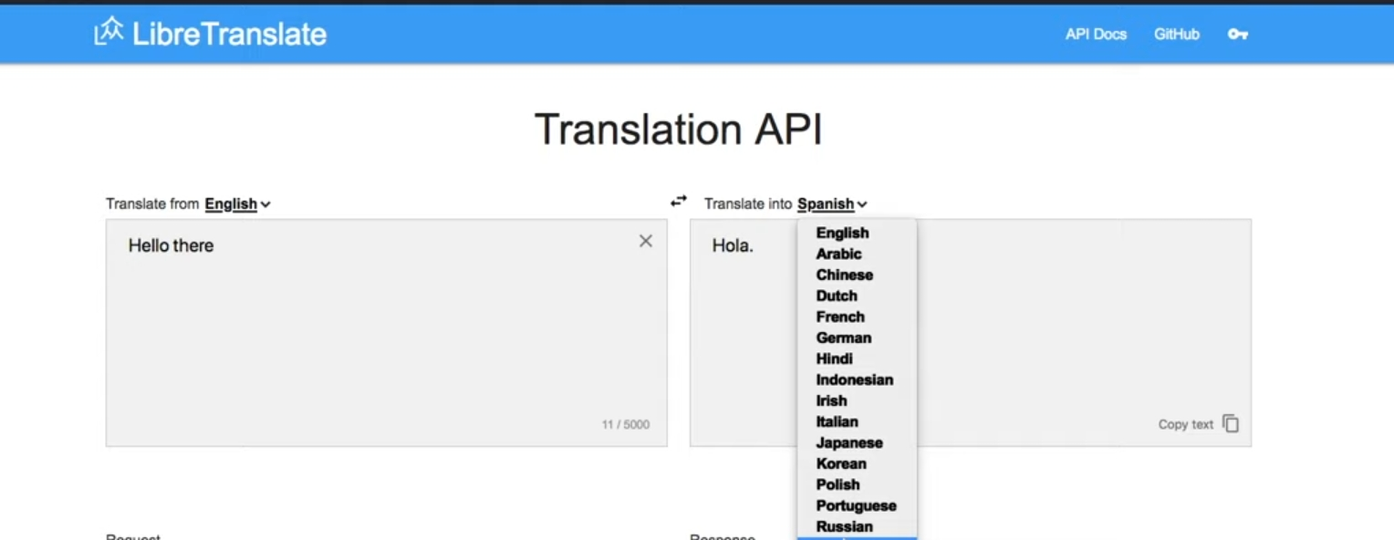
Interfaces and tests Here’s the python scrip : THE QPI

Slide 24
Conclusion
Overall this was such a nice exprience for m even tho I didn’t give my all and show all the knowledge I have and what I can do ,due to some obstacles like the tight time of the internship and the solo-work ,But still MANAR is one of unique websites out there and I’m glad that I’ve been a very small part of this big project :)
👏

Slide 25
THANK YOU :)

